Slide 2
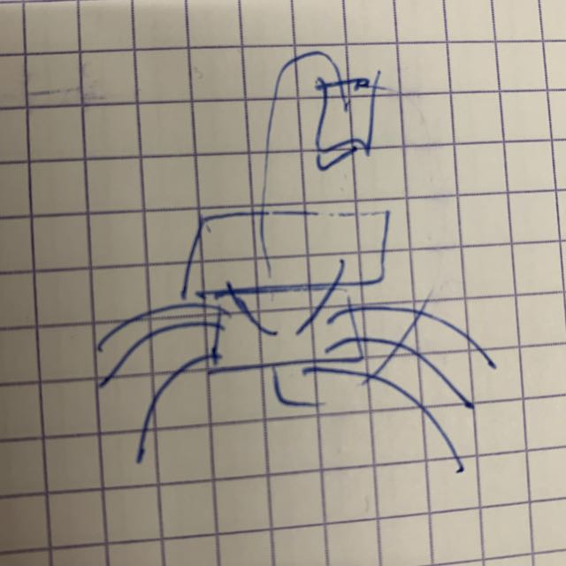
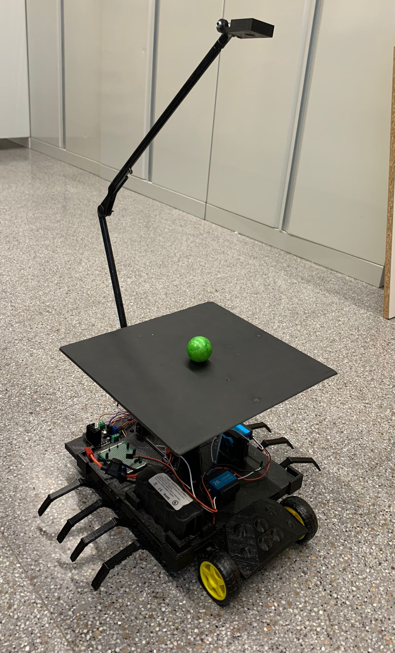
Introduction
Scorpion Balance Board

Slide 3

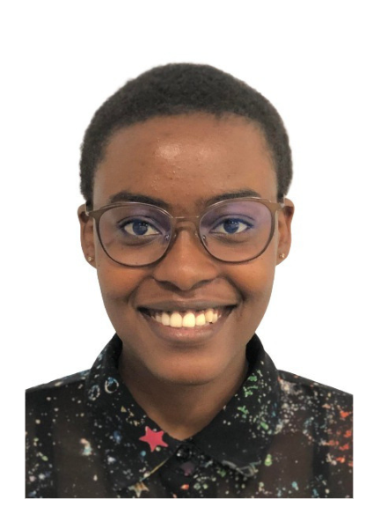


Team Organization
Isaac
Project Manager
Aïda
Electronics
David
Mechanics
Hortense
Programming

Slide 4
Objectives and motivation
Main function
The objective is to create a balancing plate using different mechanical, electrical and programming components. The goal is achieved when it can keep an object on a plate from falling.
Secondary function
Making the balancing plate mobile to increase the usability of the product. The movement will be created with two wheels attached to motors.
Challenges and novelties
The main challenge and novelty has been the mix between the balance board and the movement of the base

Slide 5
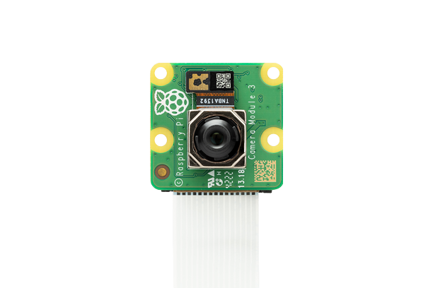
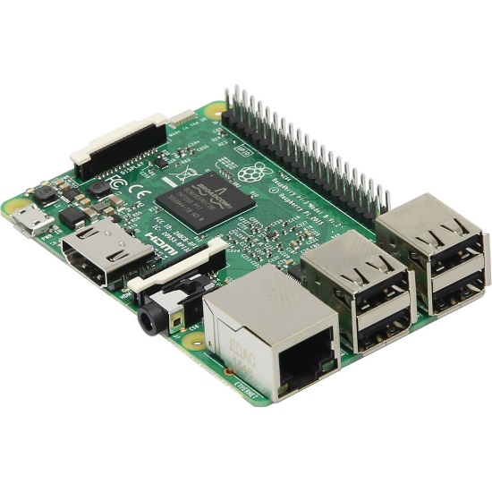
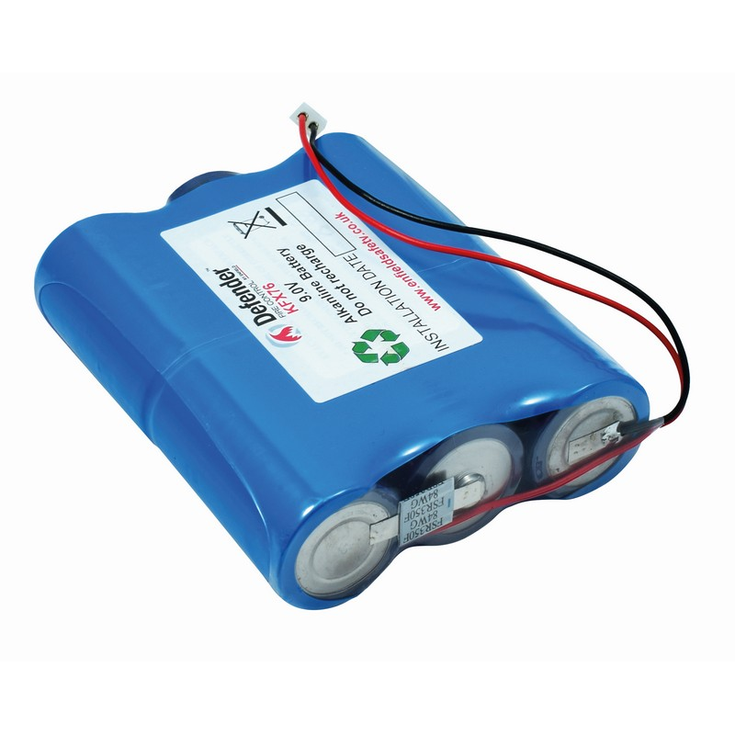
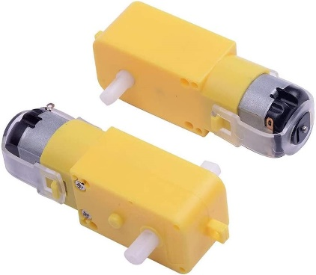
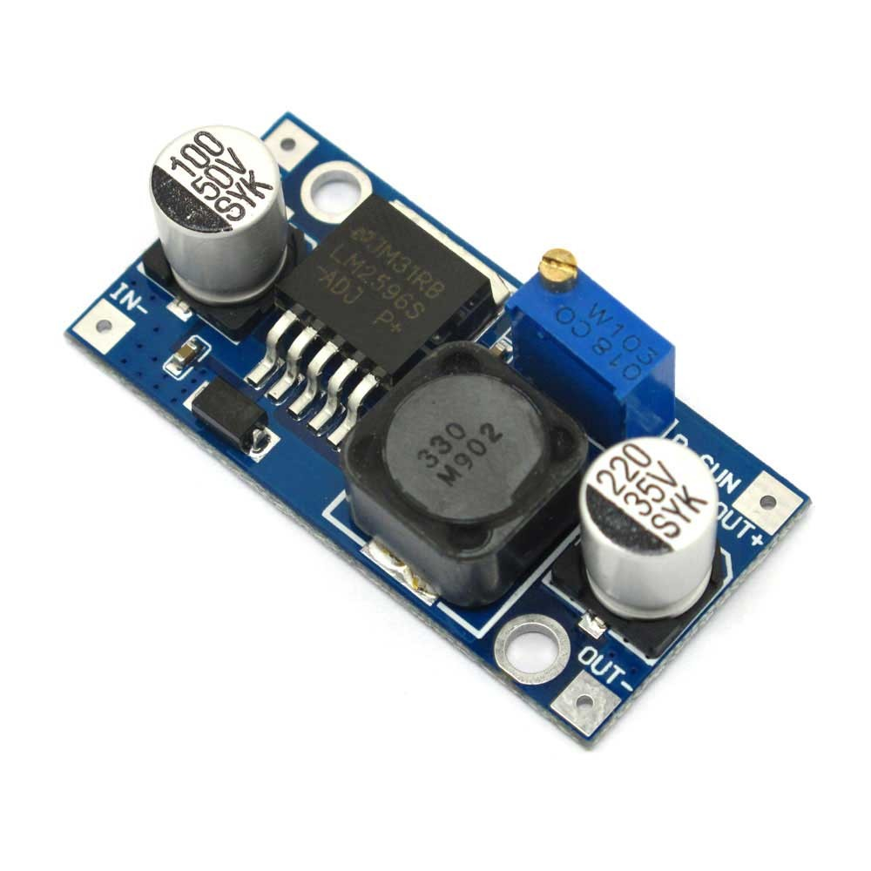
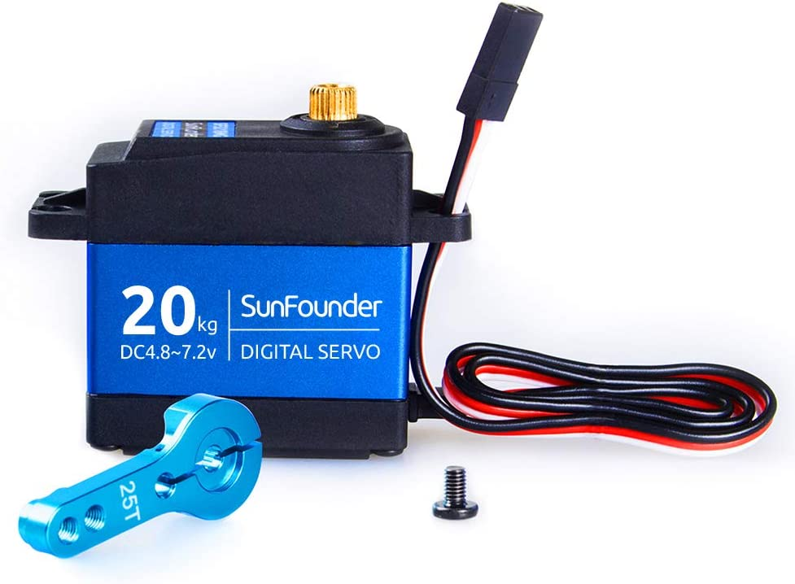
Specifications
12V
5V
12V
7.2V

Slide 6
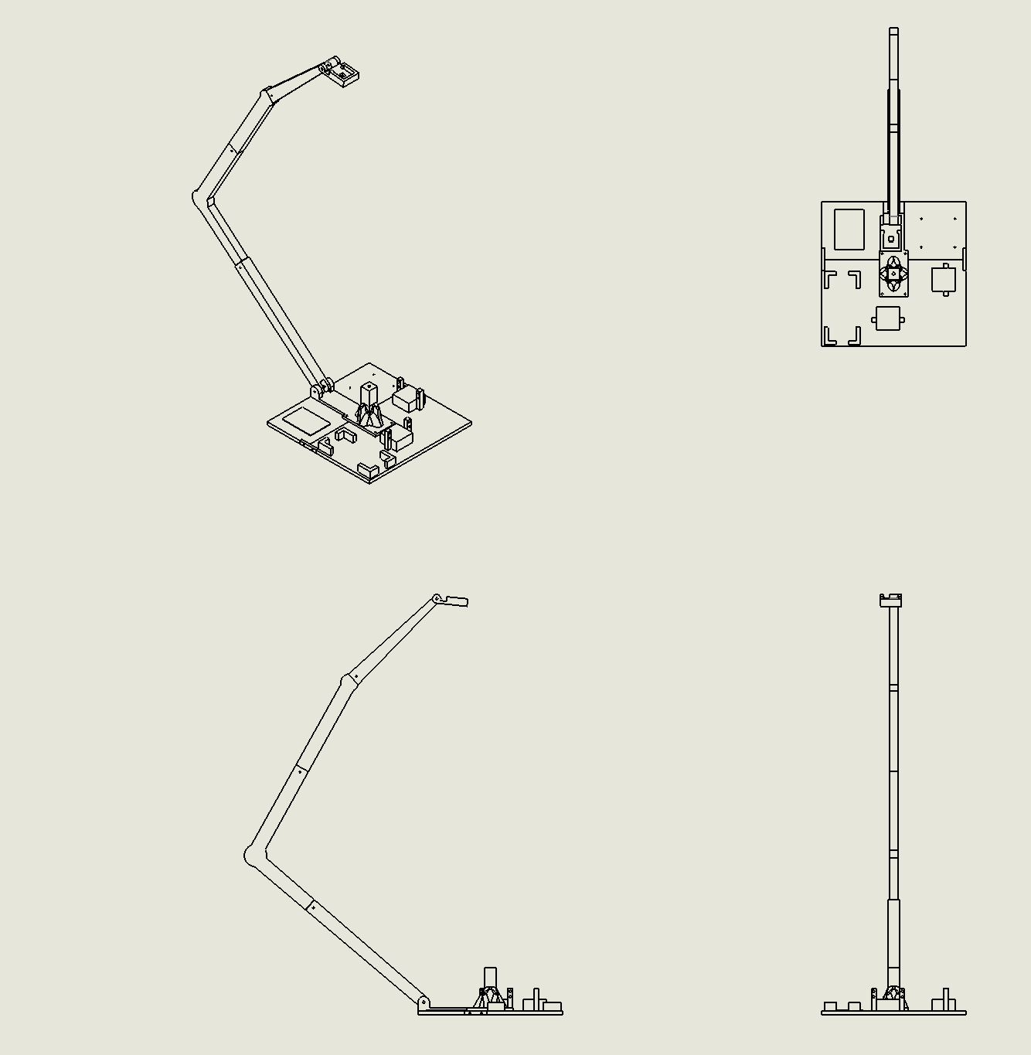
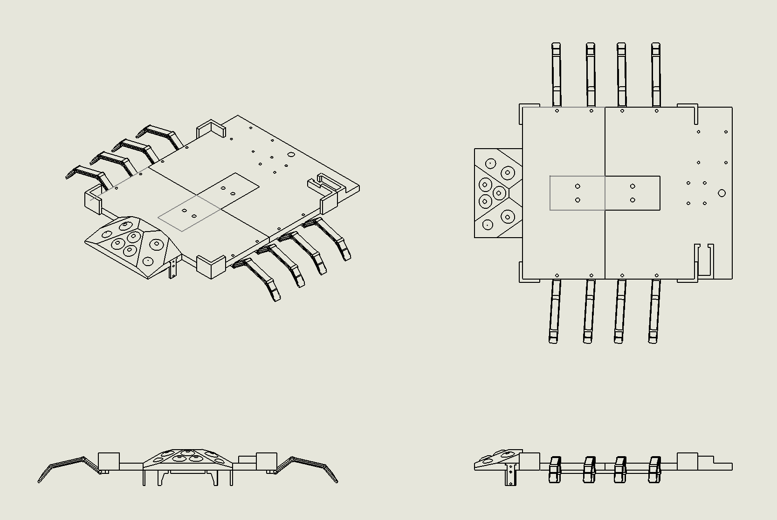
In the mechanical domain:
Technical drawing

Slide 7
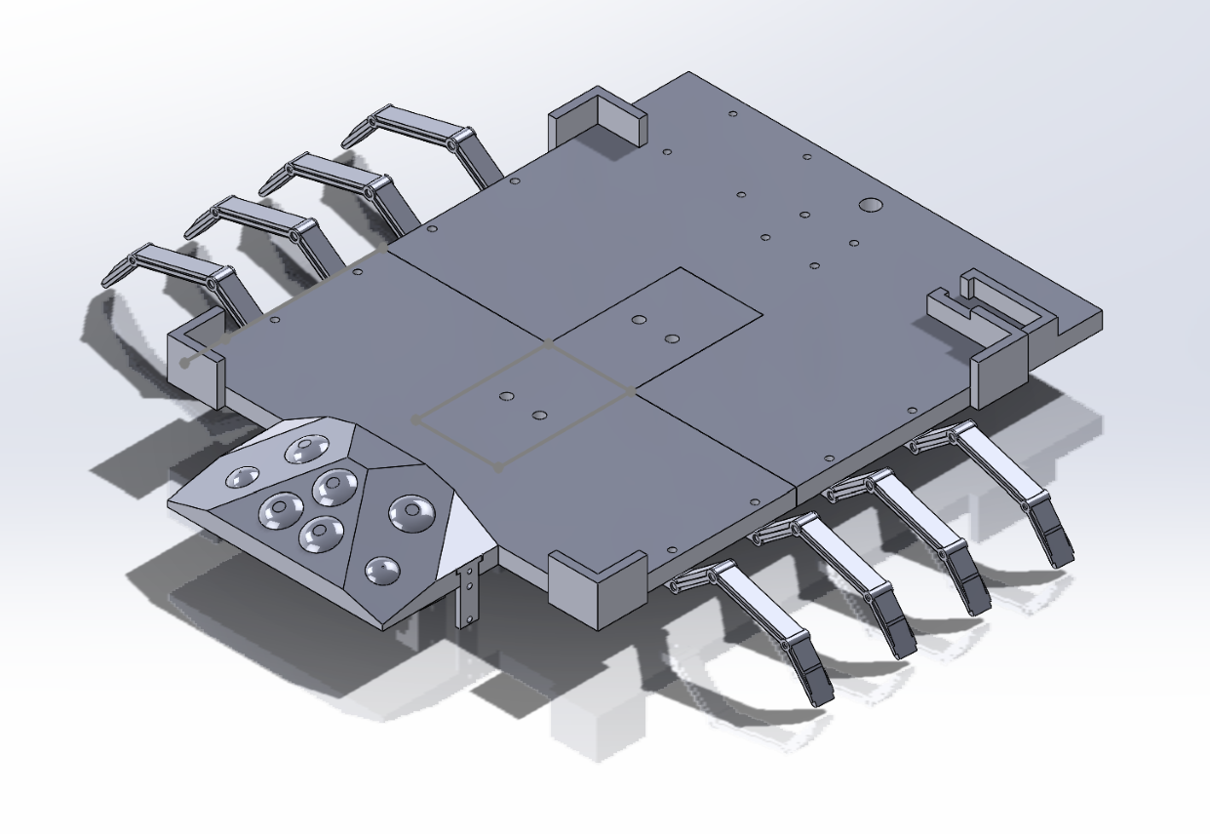
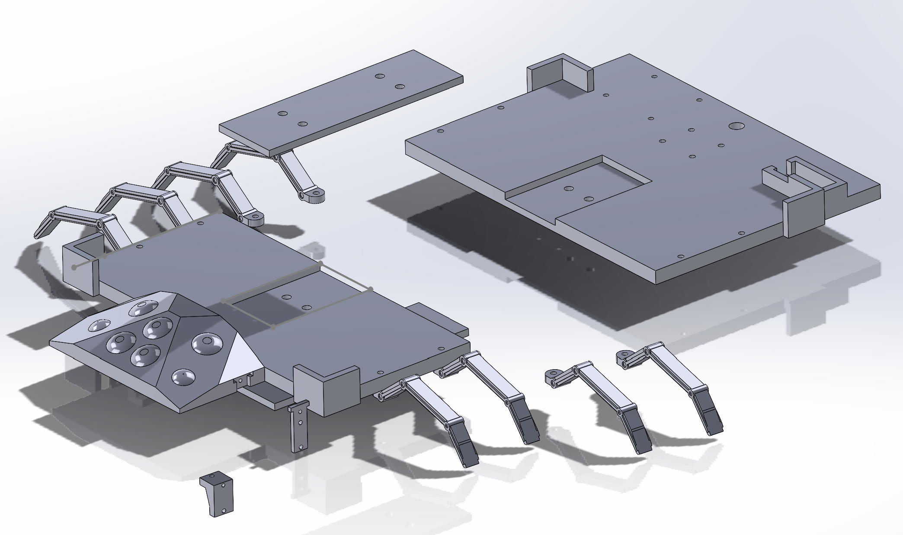
In the mechanical domain:
The ground layer made for movement

Slide 8
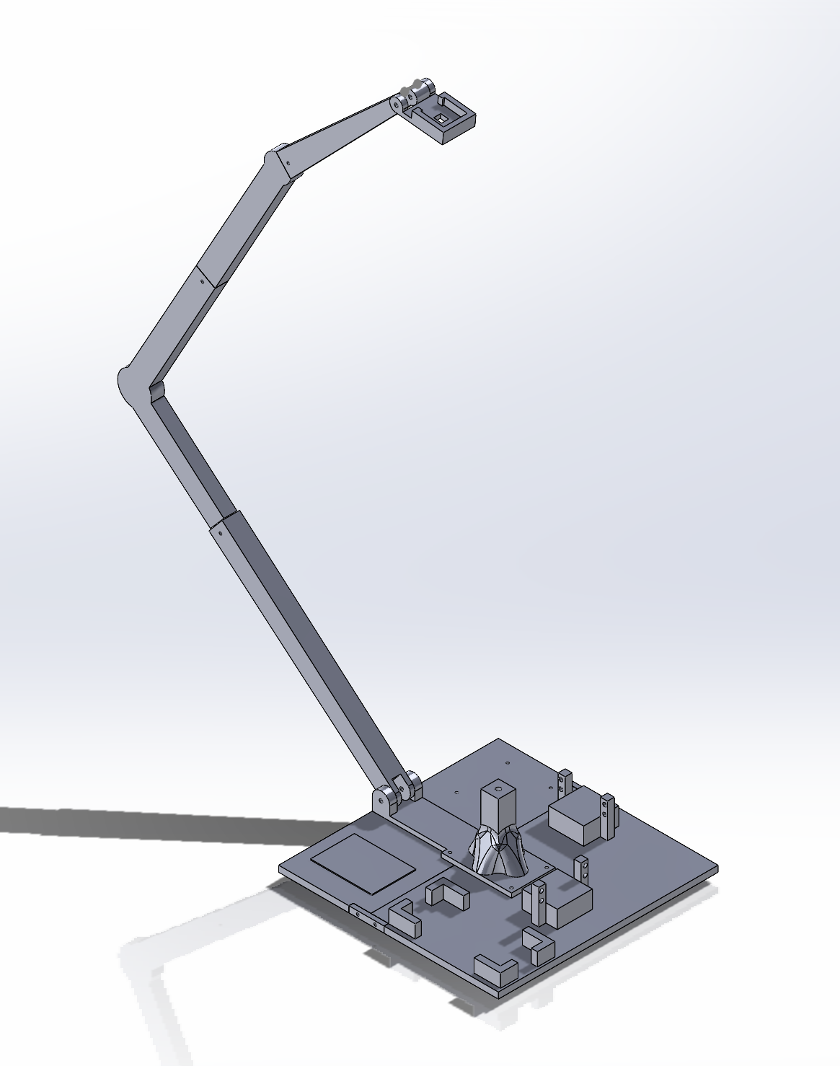
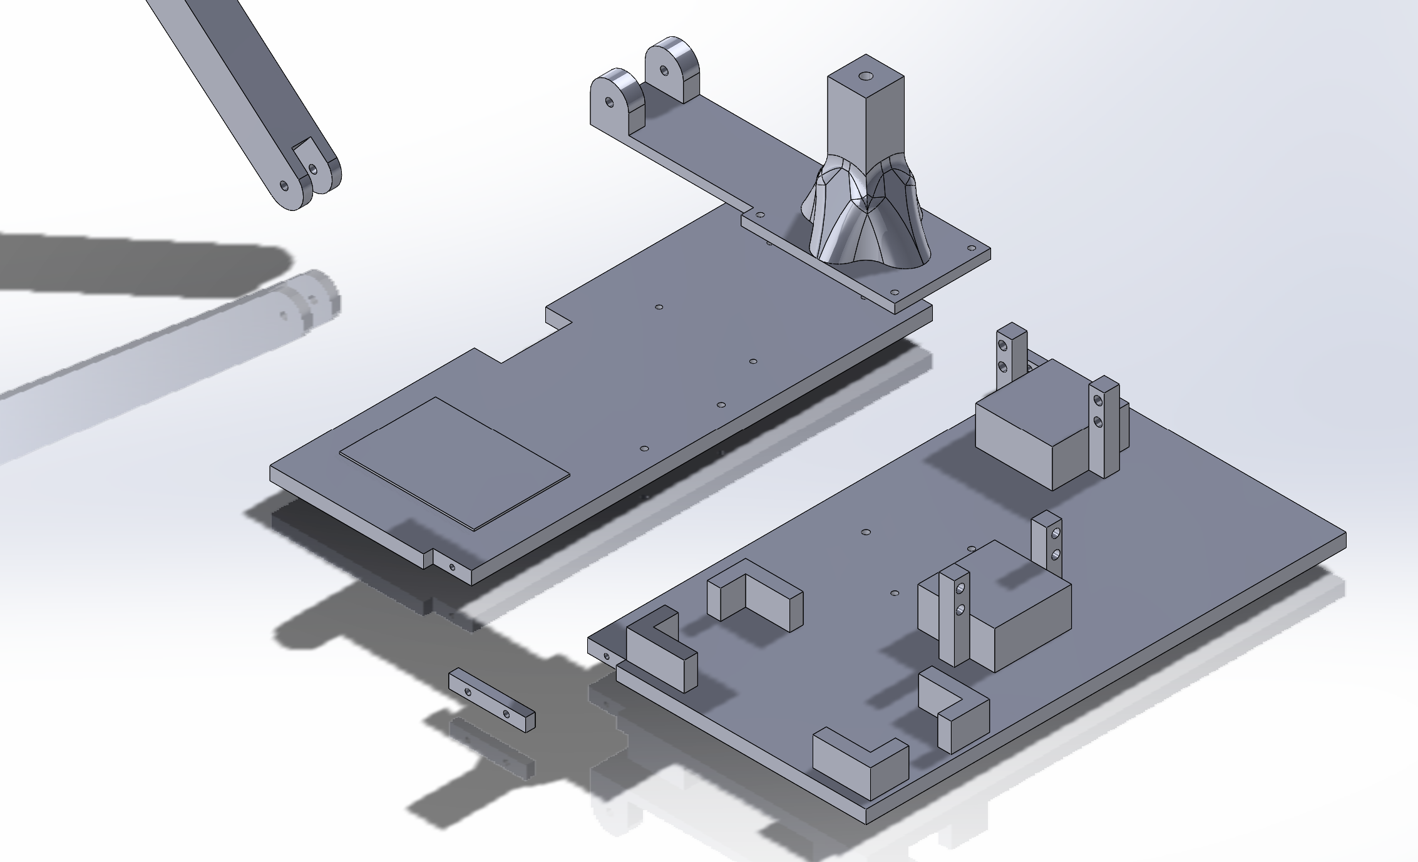
In the mechanical domain:
The actual main balance table

Slide 9

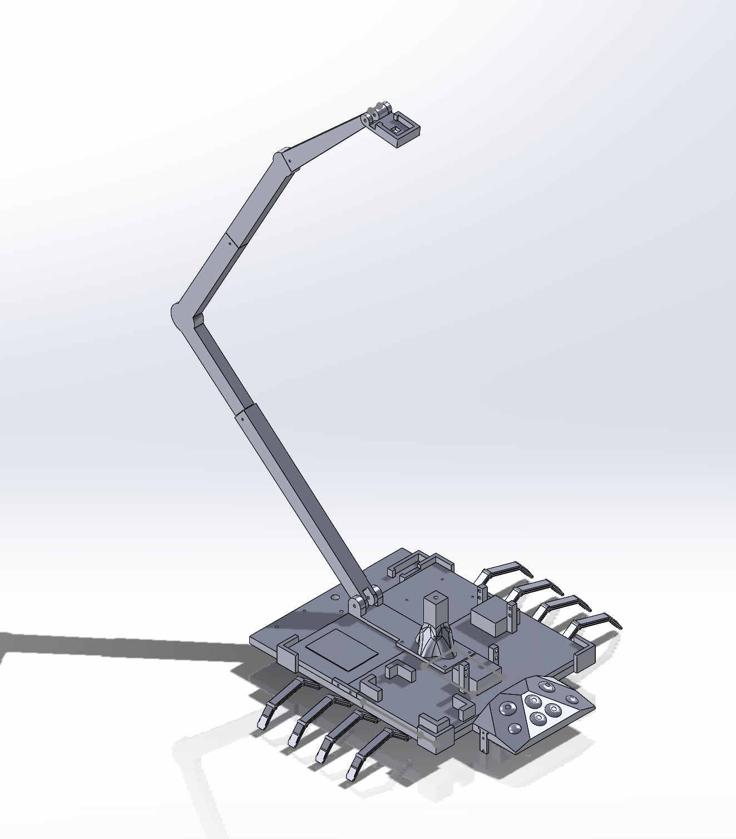
In the mechanical domain:

Slide 10
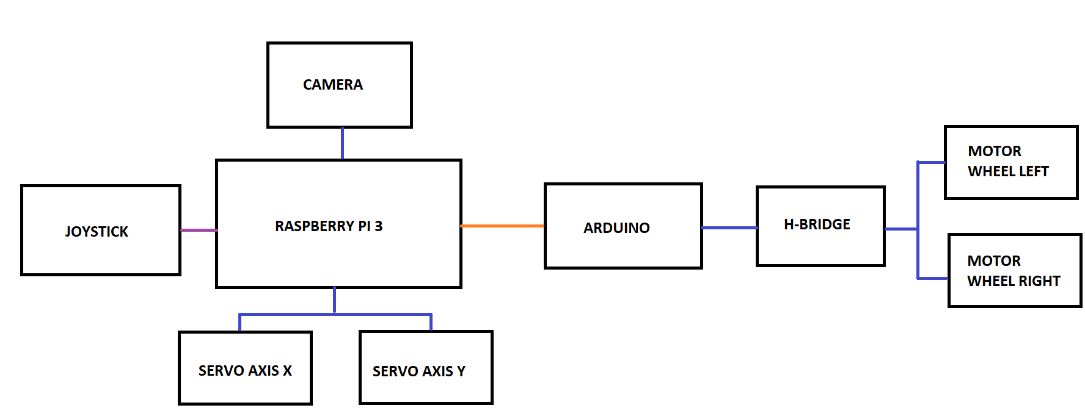
In the Electrical/Electronics domain:

Slide 11
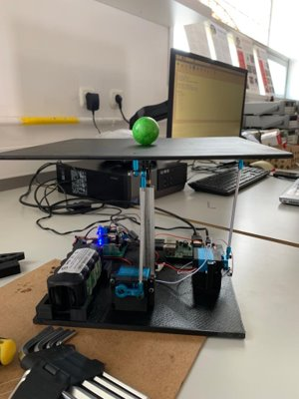
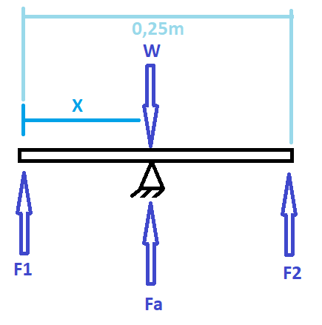

In the Electrical/Electronics domain:
$$W=3,54·0,25·0,25=0,22125Kg$$

Slide 12
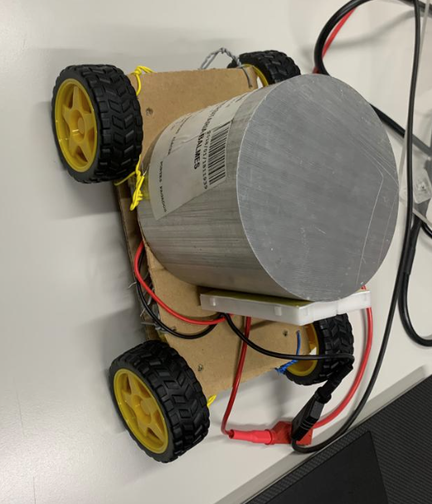
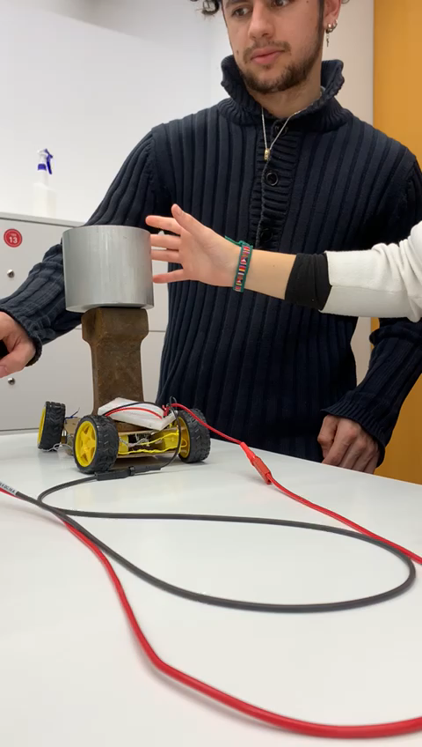
In the Electrical/Electronics domain:
To choose the DC motors for the wheels we tested with 5 Kg.

Slide 13
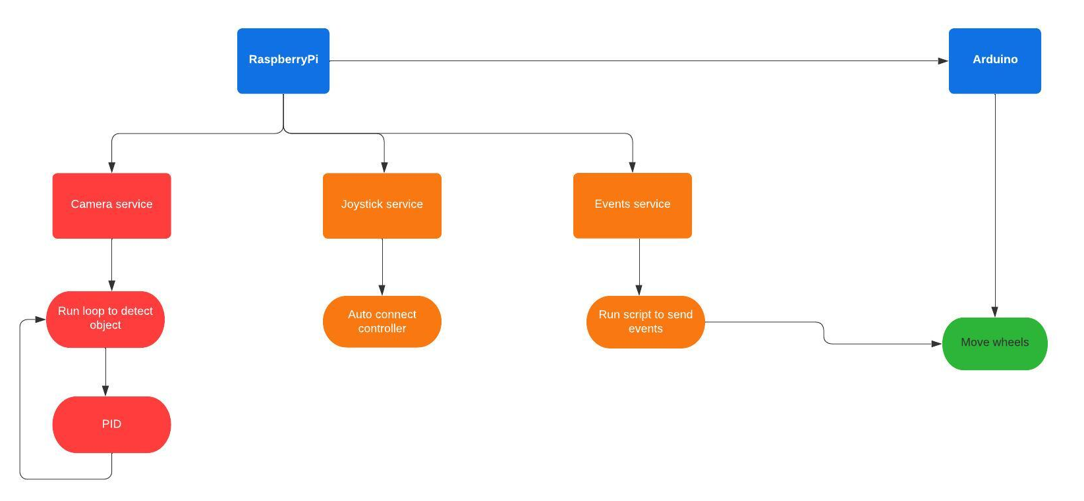
In the programming domain:
Services and PID control

Slide 14
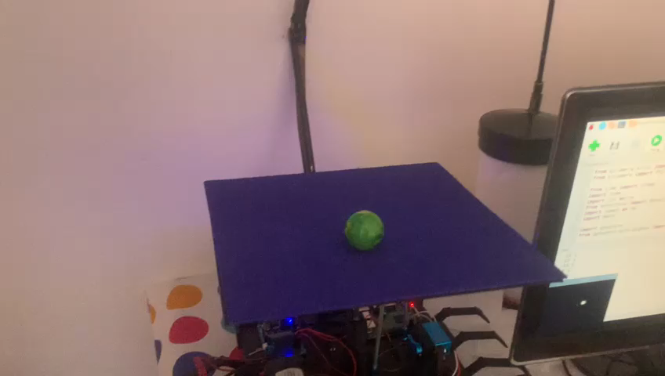
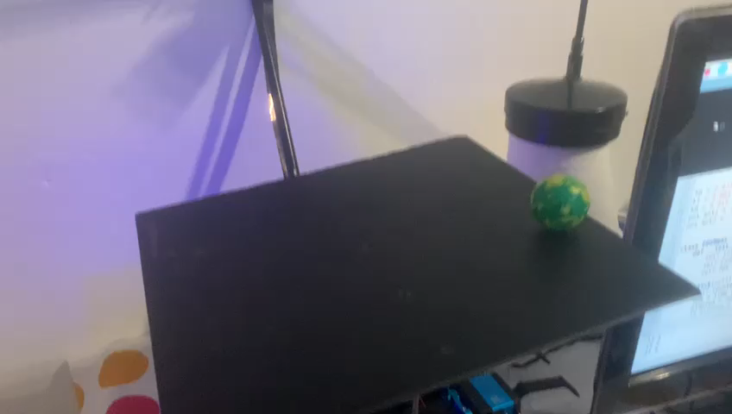
In the programming domain:
Camera service:
Image processing with HSV
Two PID controls

Slide 15
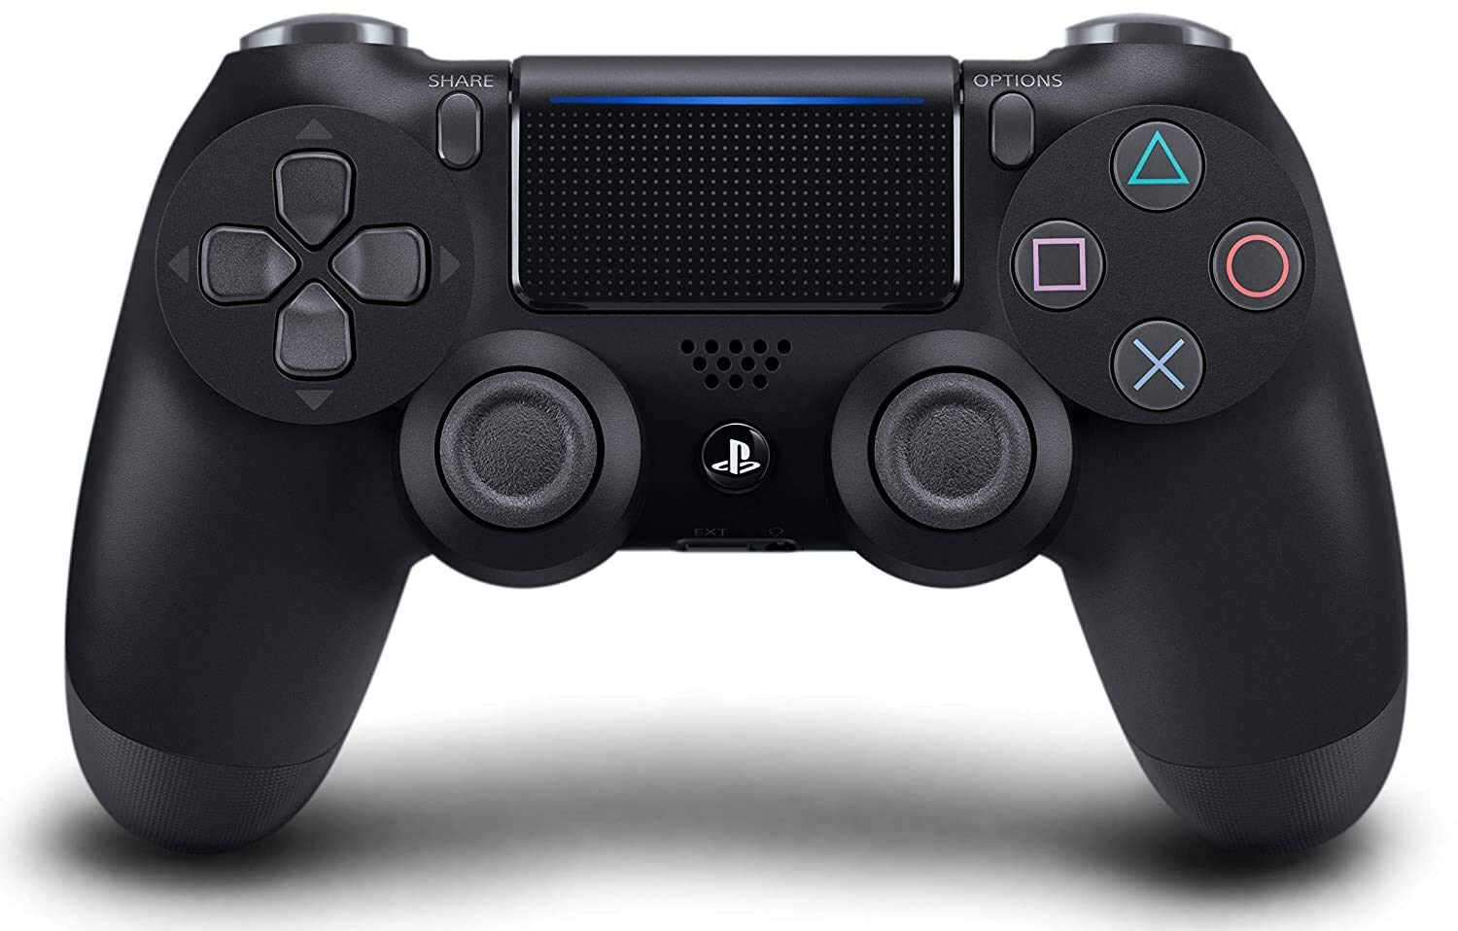
In the programming domain:
Joystick service:
Auto connection through bluetooth

Slide 16
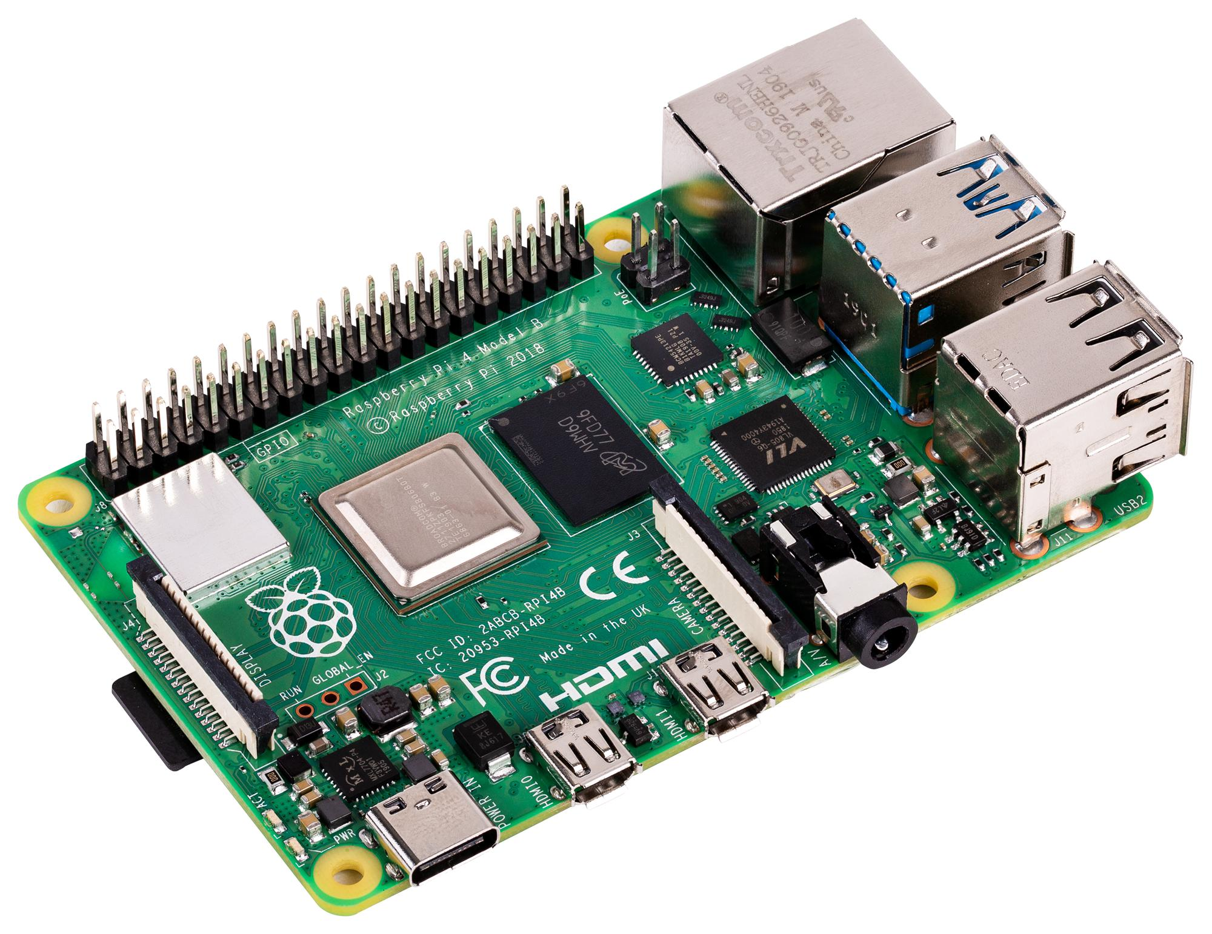
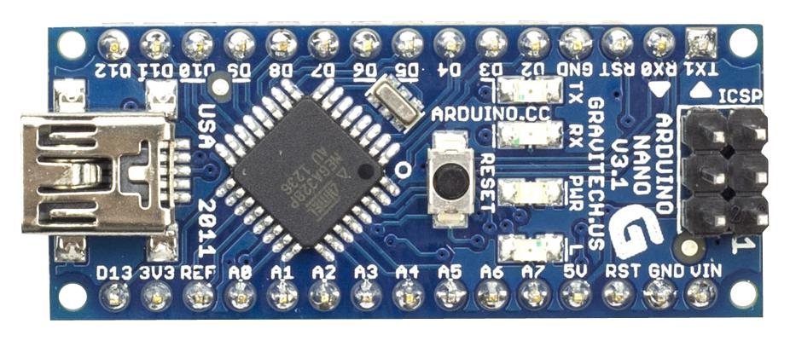
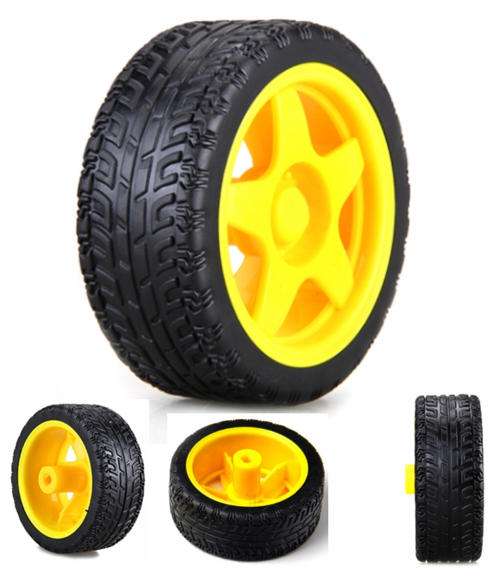
In the programming domain:
Events service:
Python script on RaspberryPi
USB connection with Arduino
Arduino script to move the wheels

Slide 17
Budget:
Budget of materials
MATERIAL PRICE
PRICE | QUANTITY | MATERIAL
59,45 € | 1 | RASPBERRY PI 3
31,70 € | 1 | RASPBERRY PI 3 CAMERA
6,99 € | 1 | SD CARD for Raspberry PI 3
27,54 € | 1 | CARDAN
16,88 € | 1 | DC Motors
4,82 € | 1 | Metraquilat 250x250mm
43,18 € | 2 | Servos base
7,33 € | 1 | Arduino nano
50,00 € | 1 | Others
247,89 €

Slide 18
Budget:
Hours and effort of team members in the project
DEVELOPMENT WORK
PRICE | HOURS | PERSON - FUNCTION | PRICE FUNCTION
4500 | 100 | Hortense Utuje - Software development | 45
4500 | 100 | David Pfaffenrod - Technical engineer | 45
4600 | 100 | Isaac Lenin Acevedo Bau - Product owner | 46
4500 | 100 | Aïda Calero Chicharro - Technical engineer | 45
18.100,00 €

Slide 19
Budget:
Budget of the project
With the material and the development work the final price to development this project: 18.347,89€
If this product is going to sold in a store, as the development is already done, the final price is 397,89€, only the material and the assembly of the technician would be charged.

Slide 20
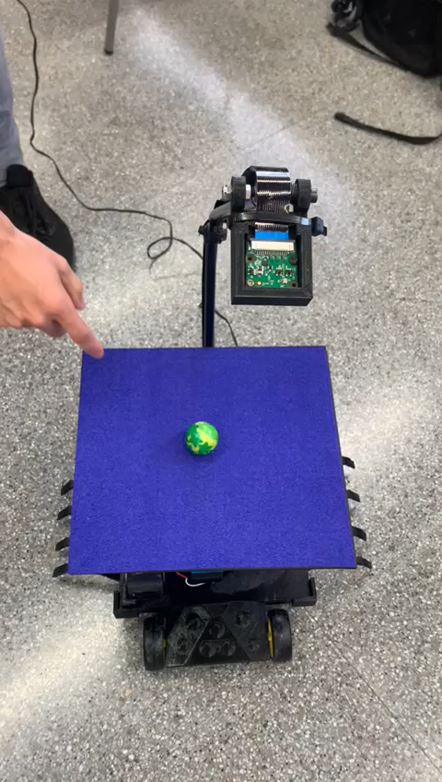
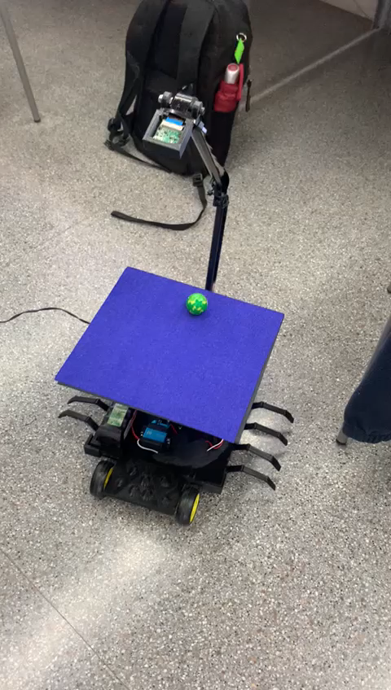
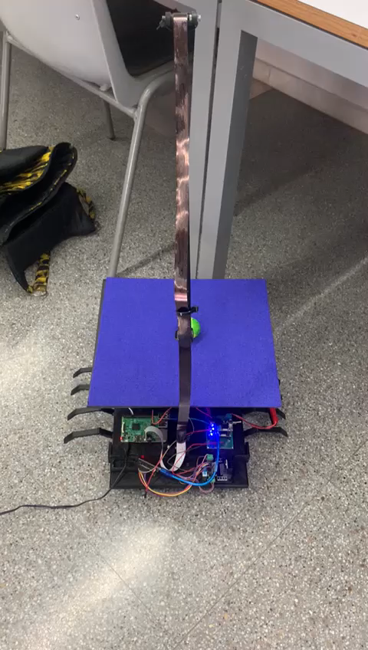
Demostrations:

Slide 21
References
Ogata, K. (2010). Modern Control Engineering. Prentice Hall.
Título: "Ball Balancing PID Control"
Autor: Giuseppe Sensolini Arrà
Repositorio: giusenso/Ball-Balancing-PID-System: Ball Balancing PID System: control of a 2 axis platform for ball stabilization w/ visual servoing. (github.com)
"Control Systems Engineering Lecture – PID Control" by nptelhrd: https://www.youtube.com/watch?v=4C8Jm1KvEJM
21

Slide 22
Website
URL with the instructables (https://www.instructables.com/) website of the project
Your website must include enough information to fully replicate your project, in the similar manner than other “Instructables” or “Do It Yourself (DIY)” repositories.
22

